Slide 1
Web Engineering
Ms Nabeela Bibi

Slide 2

What is WWW?
World Wide Web (WWW or W3), collection of globally distributed text and multimedia documents and files
Web vs. Internet

Slide 3
World Wide Web
History
The World Wide Web was developed at the European Organization for Nuclear Research (CERN).
Idea proposed by Tim Berners-Lee in 1989
To share research information on nuclear physics

Slide 4
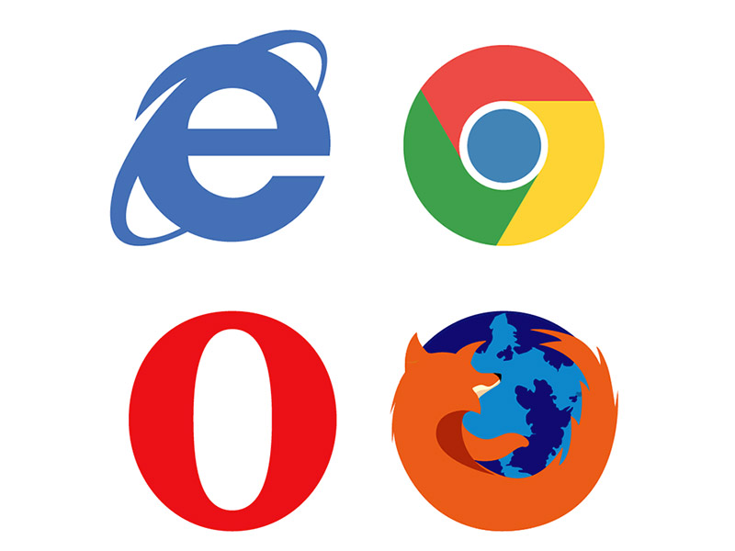
Important Concepts
The Browser
Software running on your PC like
Internet Explorer
Google chrome
Netscape
Firefox
Renders (displays) the pages on screen
Executes embedded scripts
Automatically invokes additional software as needed

Slide 5

Important Concepts
Web Server
A computer program that is responsible for accepting HTTP requests Web browsers, and sending responses which usually are Web pages such as HTML documents and linked objects (images, etc.).

Slide 6
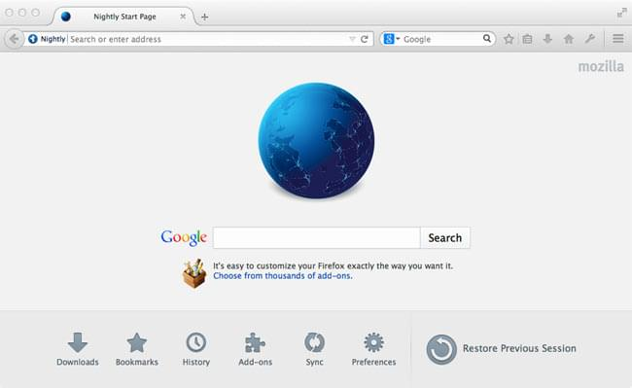
Important Concepts
Web Page
A Web page is a text document embedded with HTML tags that define how the text is rendered on screen. Web pages can be created with any text editor or word processor. They are also created in HTML authoring programs (like FrontPage, DreamWeaver) that provide a graphical interface for designing the layout

Slide 7
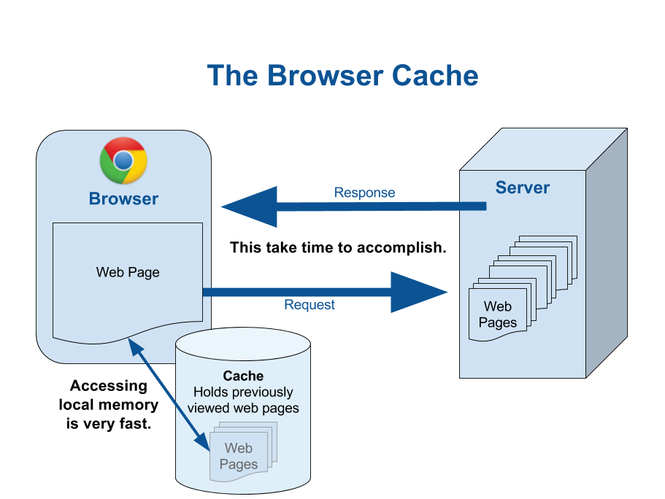
Important Concepts
Caching
Browsers save all web resources (images etc) on the local hard drive
An HTTP request will be sent by the browser that asks for the data only if it has been updated since the last download
If it has not, the cached version will be reused in the rendering step.

Slide 8
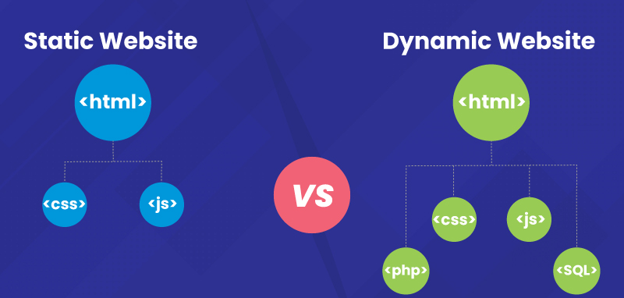
Important Concepts
Static web page
The contents of the page never change, regardless of user or request
Resume websites, portfolio, brochure websites, and other informational read-only websites.
Dynamic web page
Content (text, images, form fields, etc.) on a web page can change, in response to different contexts or conditions.
Client Side
Server Side

Slide 9
Important Concepts
Client Side
The Client-side dynamic content is generated on the client's computer.
The web server retrieves the page and sends it as is.
The web browser then processes the code embedded in the page (normally JavaScript) and displays the page to the user.

Slide 10
Important Concepts
Server Side
The browser sends an HTTP request.
The server retrieves the requested script or program.
The server executes the script or program which typically outputs an HTML web page. The program usually obtains input from the query string or standard input which may have been obtained from a submitted web form.
The server sends the HTML output to the client's browser
PHP, Perl, ASP or ASP.NET, JSP

Slide 11
How web works?
A user enters a URL into a browser (for example, http://www.google.com/index.html). This request is passed to a domain name server.
The domain name server returns an IP address for the server that hosts the Web site (for example, 212.64.250.250).
The browser requests the page from the web server using the IP address specified by the domain name server.
The web server returns the page
The browser displays the web page on user’s PC

Slide 12
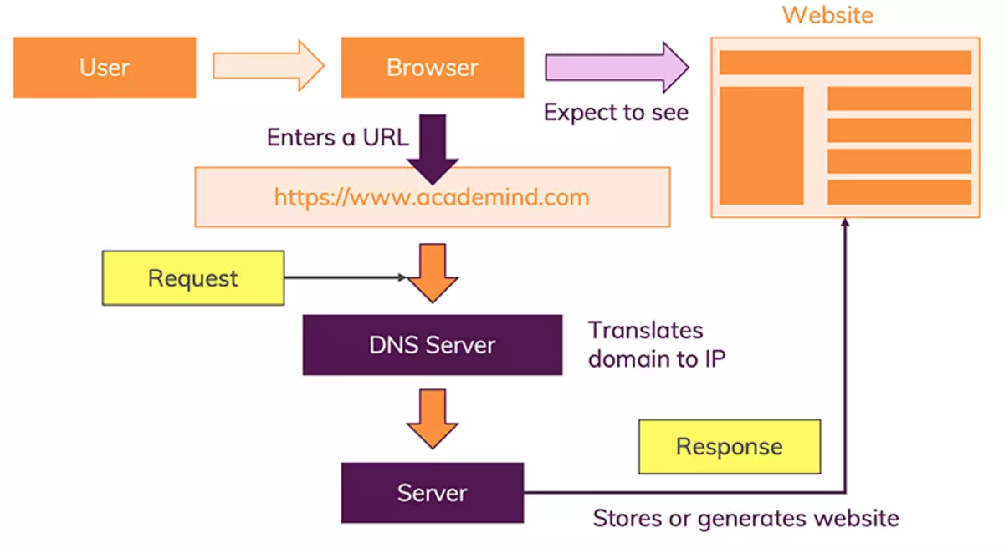
How web works?

Slide 13
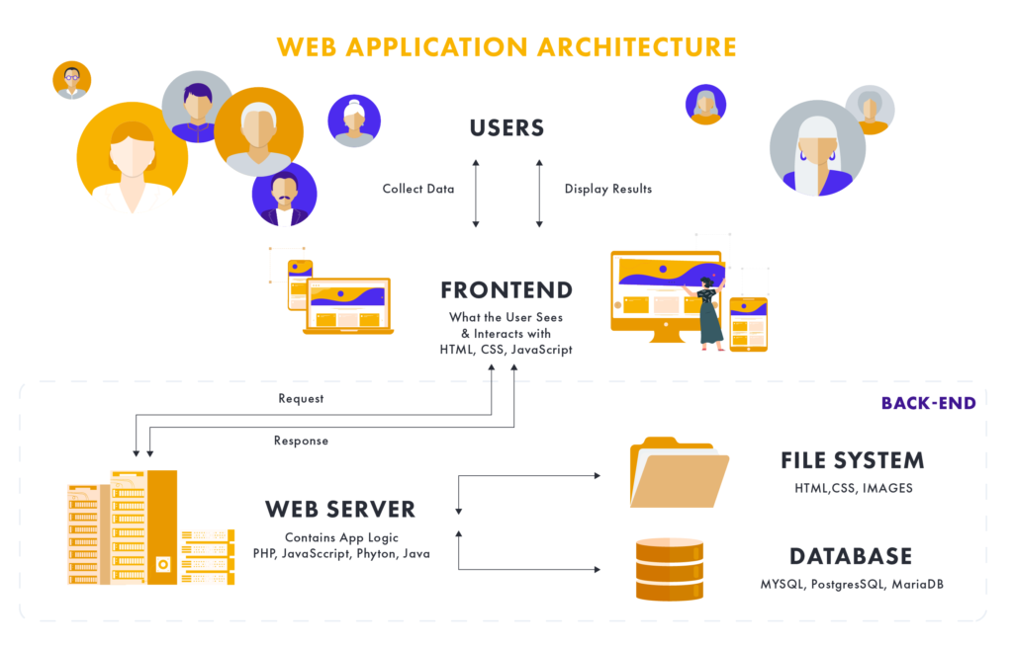
Components of a Web Application
Front-end
Back-end
Database

Slide 14
Web Application Development Languages
Front-end Development
HTML: Hyper Text Markup Language
CSS: Cascading Style Sheet
JavaScript: Client-Side Scripting language
Back-end Development
PHP: Server Side Scripting Language
MySQL: Database Language

Slide 15


